Slide 1
Personal Learning: Taking Ownership of Learning Online: Part One
Stephen Downes
August 27, 2020
https://www.downes.ca/presentation/525

Slide 2
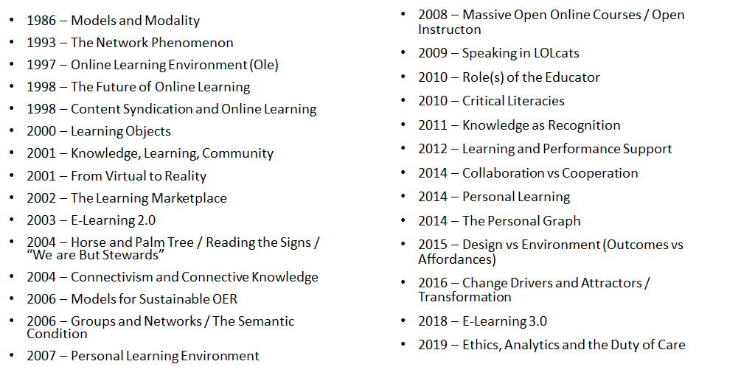
Three Decades of Enquiry

Slide 3
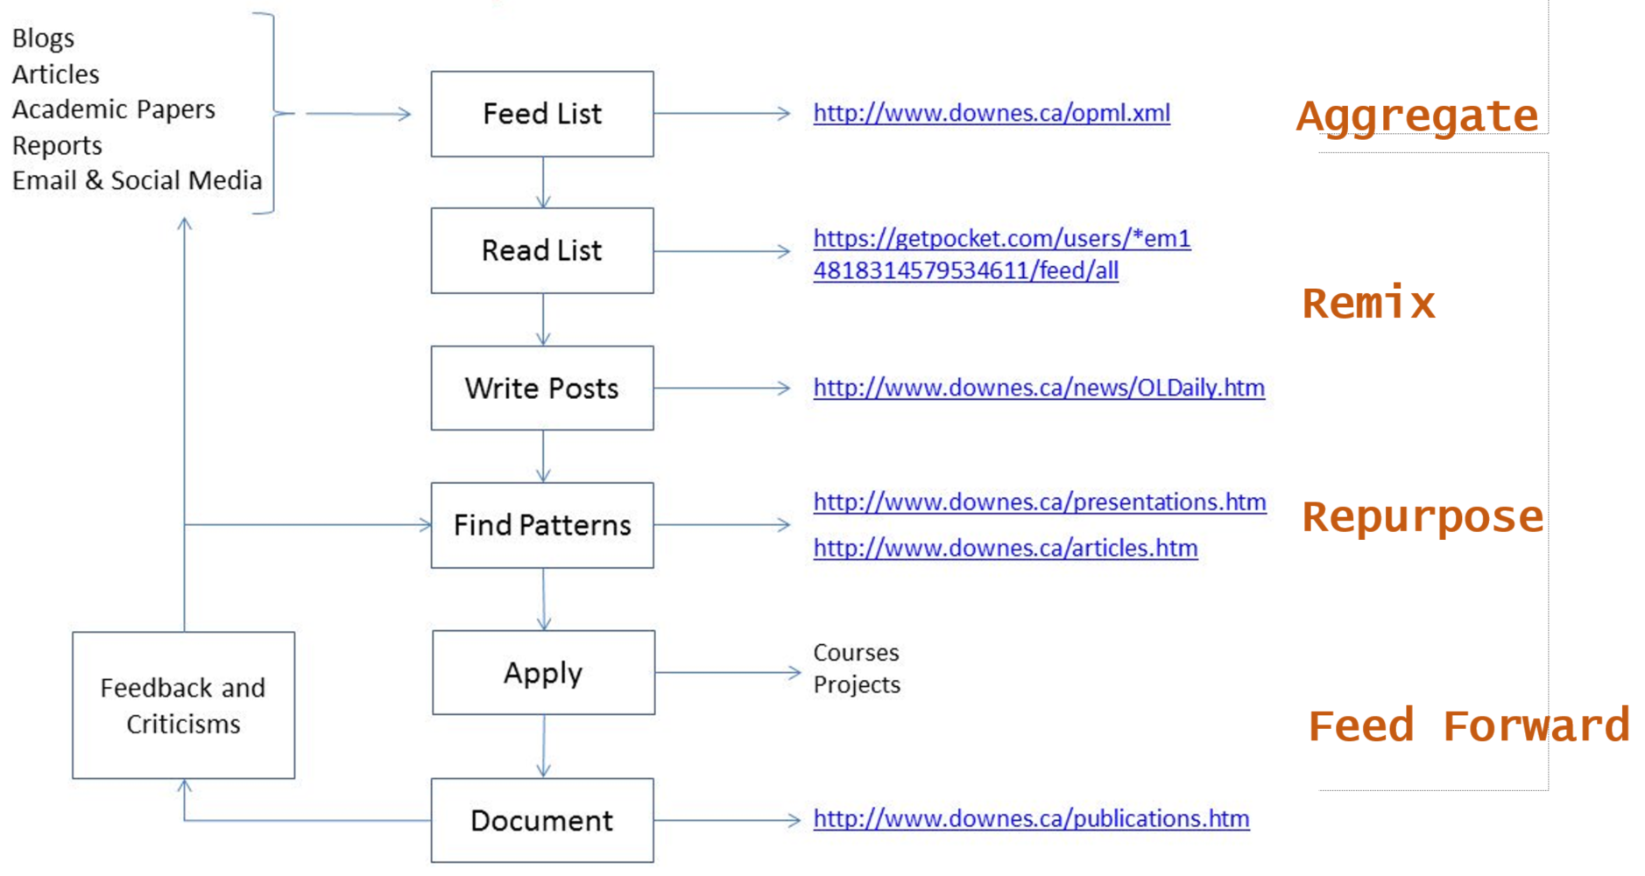
My Research Workflow

Slide 4
Takeaways for this Webinar
In this webinar, you learn:
The difference between ‘personalized learning’ and ‘personal learning’.
Why personal learning is the preferred concept for student success.
Key starting points for personal learning, objectives, learning processes and forms of evaluation that best suit personal learning.
Strategies to implement personal learning in the form of support for remote teaching, online learning, and lifelong learning.

Slide 5
Topics for Discussion - Practical
What are relevance, usability, interactivity?
Starting points
Supporting them when they’re not supported (a.k.a. Geurilla Tactics)
These slides will be available at: https://www.downes.ca/presentation/525
Silhouette Images via Gordon Johnson https://pixabay.com/users/gdj-1086657/

Slide 6
Topics for Discussion - Theory
What is personal learning?
Personal learning starting points
Supporting personal learning online
These slides will be available at: https://www.downes.ca/presentation/5245
Silhouette Images via Gordon Johnson https://pixabay.com/users/gdj-1086657/

Slide 7
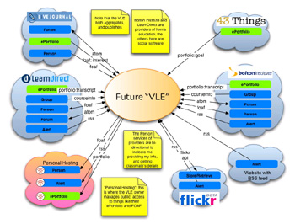
Three Principles:
Interaction – participation in a learning community (or a community of practice)

Slide 8
Three Principles:
Usability – simplicity and consistency

Slide 9
Three Principles:
Relevance – or salience, that is, learning that is relevant to you, now

Slide 10
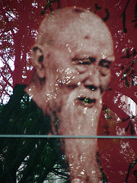
Interaction:
Why do we want it?
Human contact … talk to me…
Human content … teach me…
“… the capacity to communicate with other people interested in the same topic or using the same online resource.”

Slide 11
Interaction: How to Get It
You cannot depend on traditional learning for interactivity…
Most learning based on the broadcast model
Most interactivity separated from learning

Slide 12
Interaction: How to Get It
Built your own interaction network
Place yourself, not the content, at the centre
YOU

Slide 13
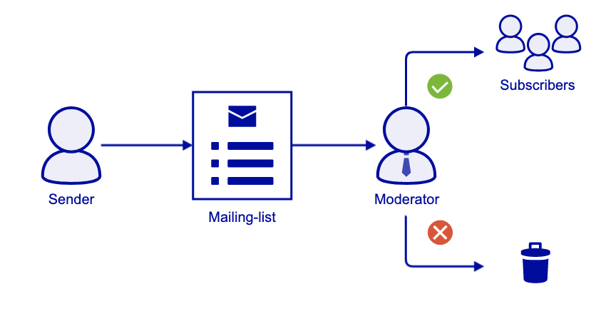
Interaction: Your Personal Network
Email and mailing lists
Google Groups
Institutional Lists
https://it.ubc.ca/services/email-voice-internet/mailing-lists

Slide 14
Interaction: Your Personal Network
Blogging – reading your subscriptions, leaving comments, longer responses in your own blog
Wordpress
Edublogs
Blogger

Slide 15
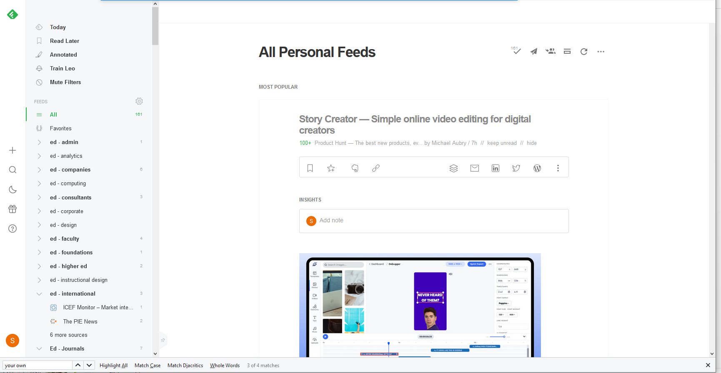
Interaction: Your Personal Network
Personal communication – instant messaging, Skype
Social Networks – Twitter, Mastodon
RSS – Feedly
https://feedly.com

Slide 16
Interaction: Principles
Pull is better than push…
Speak in your own (genuine) voice (and listen for authenticity)
Share your knowledge, your experiences, your opinions
Make it a habit and a priority

Slide 17
Interaction: Guerilla Tactics
If interaction isn’t provided, create it…
Eg., if you are at a lecture like this, blog it

Slide 18
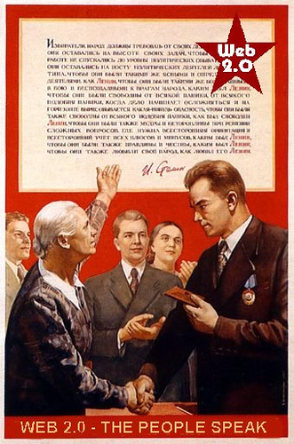
Interaction: Guerilla Tactics
If your software doesn’t support interaction, add it
Eg., embed Javascript comment, RSS in LMS pages

Slide 19
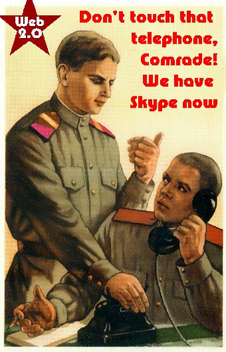
Interaction: Guerilla Tactics
Use back-channels
Private lists, Gmail accounts,
Flickr, IM, more…

Slide 20
Usability:
Elements of Usability
Consistency … I know what to expect…
Simplicity … I can understand how it works…
“… probably the greatest usability experts are found in the design labs of Google and Yahoo!”

Slide 21
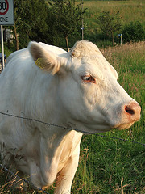
Consistency? As a Learner?
Yes! Take charge of your learning…

Slide 22
Consistency? As a Learner?
Clarify first principles…
for example, how do you understand learning theory? Eg. Five Instructional Design Principles Worth Revisiting

Slide 23
Consistency? As a Learner?
Organize your knowledge
For example, build your own CMS (using, say, Drupal)

Slide 24
Simplify the Message
Summarize, summarize, summarize
(and then put it into your own knowledge base)

Slide 25
Simplify the Message
Use your own vocabulary, examples
You own your language – don’t let academics and (especially) vendors tell you what jargon to use

Slide 26
Simplify the Message
Don’t compartmentalize (needlessly)

Slide 27
Usability: Principles
Usability is Social:
Can you search your own learning?
Do you represent similar things in similar ways?
Usability is Personal:
Listen to yourself
Be reflective – eg., is your desktop working for you?

Slide 28
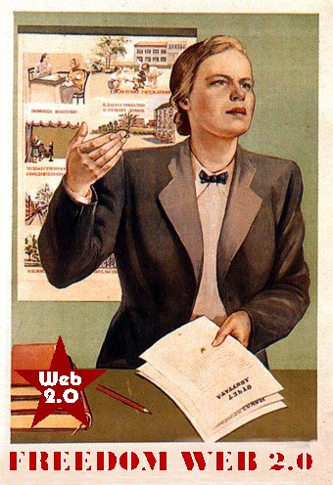
Usability: Guerilla Tactics
Important: your institutional CMS is almost certainly dysfunctional – create your own distributed knowledge management system…

Slide 29
Usability: Guerilla Tactics
Create a blog on Blogger, just to take notes

Slide 30
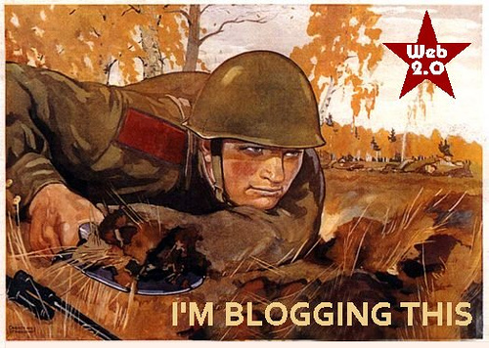
Usability: Guerilla Tactics
Store photos on Flickr

Slide 31
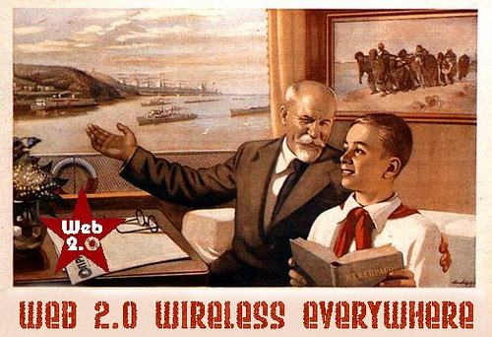
Usability: Guerilla Tactics
Create a GMail account and forward important emails to yourself (and take advantage of Google’s search)

Slide 32
Usability: Guerilla Tactics
(Maybe) use Google desktop search

Slide 33
Relevance:
Generating Relevance
Content … getting what you want
Location, location, location…
“… learners should get what they want, when they want it, and where they want it “

Slide 34
Getting What You Want
Step One: maximize your sources – today’s best bet is RSS – go to www.google.com/reader, set up an account, and search for topics of interest

Slide 35
Getting What You Want
Step Two: filter ruthlessly – if you don’t need it now, delete it (it will be online somewhere should you need it later)

Slide 36
Stephen Downes
https://www.downes.ca

